Slide 1
Chapter 8

Slide 2
Objectives

Slide 3
Objectives (continued)

Slide 4
The equality operators

Slide 5
Unusual results with the equality operator

Slide 6
The identity operators

Slide 7
Terms

Slide 8
The relational operators

Slide 9
Comparing strings to numbers with the relational operators

Slide 10
Unusual results with the relational operators

Slide 11
The logical operators

Slide 12
The logical operators in compound conditional expressions

Slide 13
The order of precedence for conditional expressions

Slide 14
The logical operators in complex conditional expressions

Slide 15
Example 1: An if statement without braces for the clauses

Slide 16
Example 3: An if statement to determine a student’s letter grade

Slide 17
Example 4: A nested if statement to determine if a year is a leap year

Slide 18
A switch statement with a default case

Slide 19
A switch statement with fall through

Slide 20
Syntax of the conditional operator

Slide 21
Examples of the conditional operator

Slide 22
How conditional operators can be rewritten with if statements

Slide 23
How to use the AND and OR operators to select values

Slide 24
How to use the OR operator to provide a default value

Slide 25
How to use the AND operator to make sure an object exists before using it

Slide 26
How to use the AND and OR operators in a complex selection

Slide 27
How selections can be rewritten with if statements

Slide 28
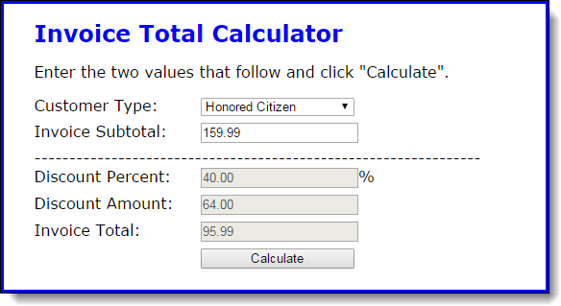
The user interface of the Invoice application

Slide 29
Some of the HTML for the application

Slide 30
Some of the HTML (continued)

Slide 31
The JavaScript for the Invoice application

Slide 32
The JavaScript (continued)

Slide 33
The JavaScript (continued)

Slide 34
The JavaScript (continued)

Slide 35
Example 1: A while loop that counts dice rolls until a six is rolled

Slide 36
Example 2: Nested while loops that get the average and max to roll a six

Slide 37
Example 3: A do-while loop that finds the maximum and minimum values

Slide 38
Example 3: A do-while loop (continued)

Slide 39
The for statement compared to the while statement

Slide 40
Example 1: A for loop to display even numbers from 2 to 10

Slide 41
Example 3: A for loop to display all the factors of a number

Slide 42
Example 4: A for loop to determine if a number is prime

Slide 43
Example 1: The break statement in a while loop

Slide 44
Example 2: The break statement in a for loop

Slide 45
Example 3: The continue statement in a for loop

Slide 46
Example 4: The continue statement in a while loop

Slide 47
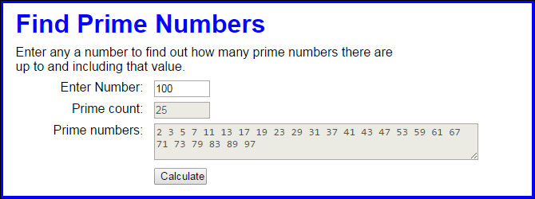
Exercise 8-1 Work with loops and primes

Slide 48
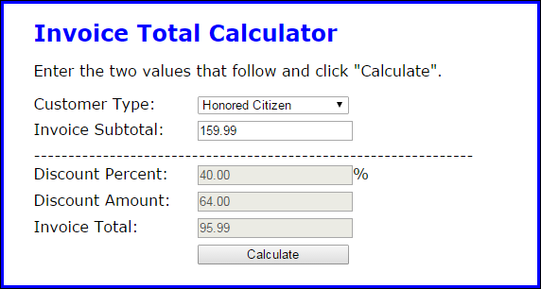
Exercise 8-2 Use if and switch statements

Slide 49
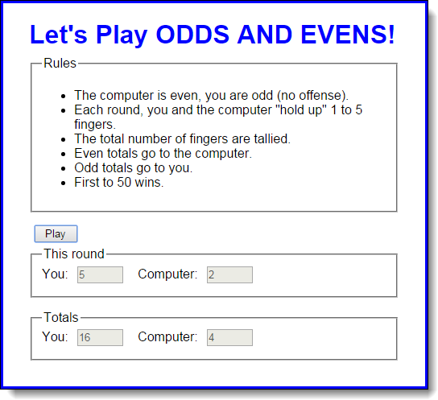
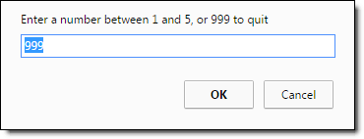
Extra 8-1 Develop an Odds and Evens game

Slide 50
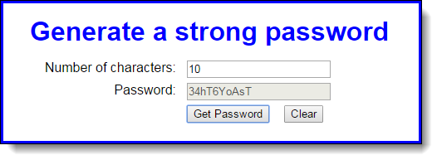
Extra 8-2 Develop a password generator

Slide 51
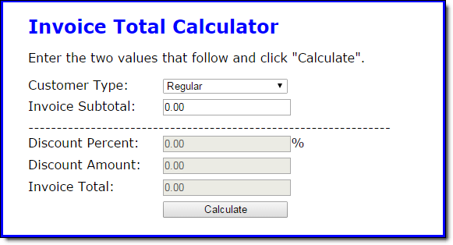
Short 8-1 Add a default subtotal

